Slide 1
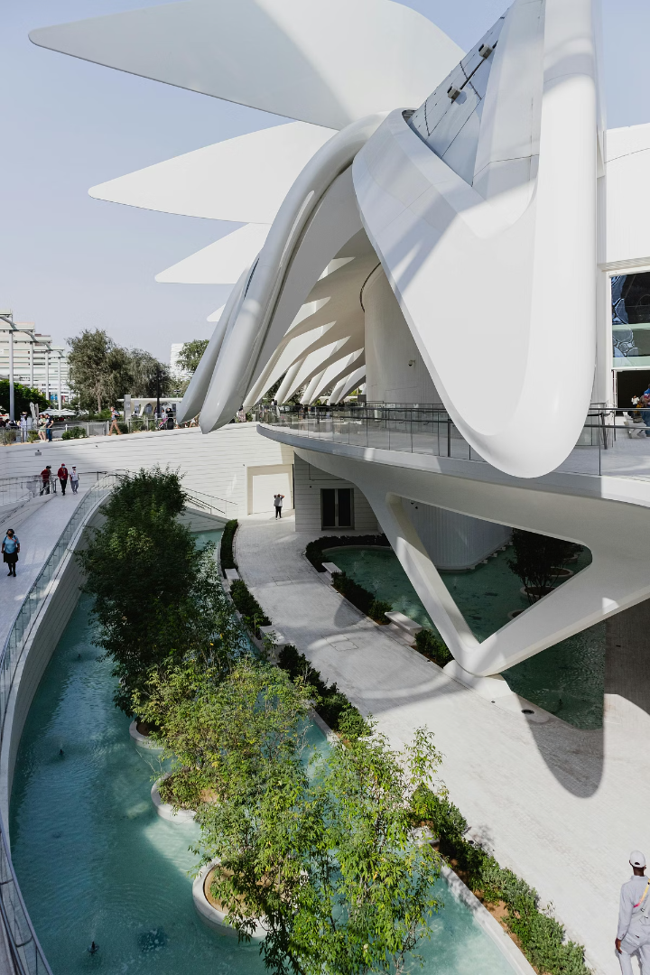

Modern Building Materials: Shaping the Future of Construction
Explore cutting-edge materials revolutionising today's construction industry.
From sustainability to technology, these innovations shape tomorrow's buildings.
by София Караченко

Slide 2
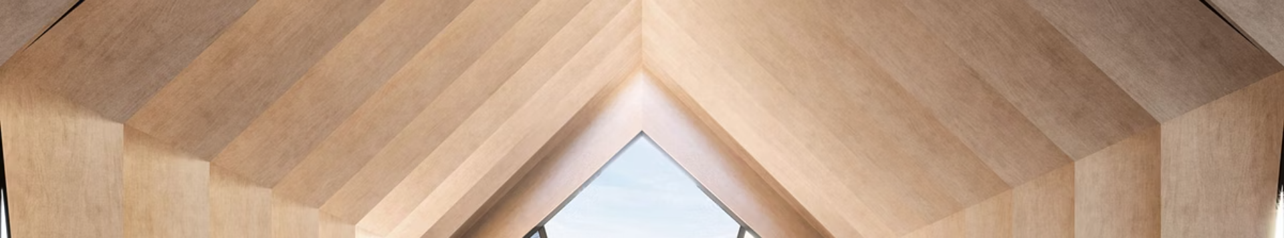
Sustainable Timber: Environmental Benefits and Applications
Eco-Friendly
Versatile Use
Renewable resource with low carbon footprint.
Ideal for framing, flooring, and interior finishes.
Durability
Aesthetic Appeal
Modern treatments enhance moisture and pest resistance.
Warm, natural look complements sustainable designs.

Slide 3
Advanced Concrete Composites: Strength, Durability and Design Potential
High Strength
Design Flexibility
Longevity
Engineered with fibres and additives for superior load-bearing.
Shapes and textures allow for creative architectural expression.
Resistant to cracks, weathering and chemical exposure.

Slide 4
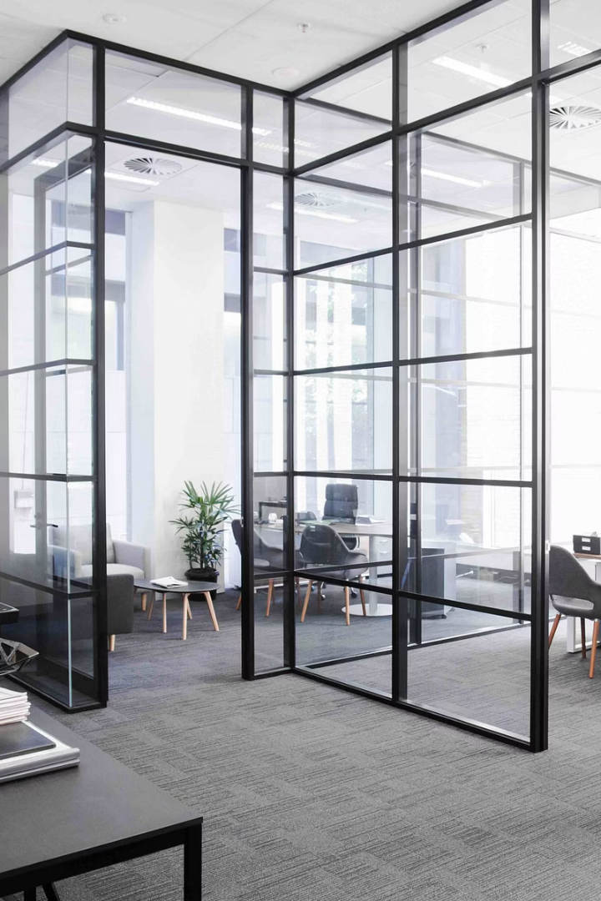



Smart Glass: Energy Efficiency and Integrated Technology
Solar Control
Connectivity
Energy Savings
Adjusts transparency to manage heat and light.
Interfaces with building systems for automation.
Reduces cooling and lighting costs.

Slide 5
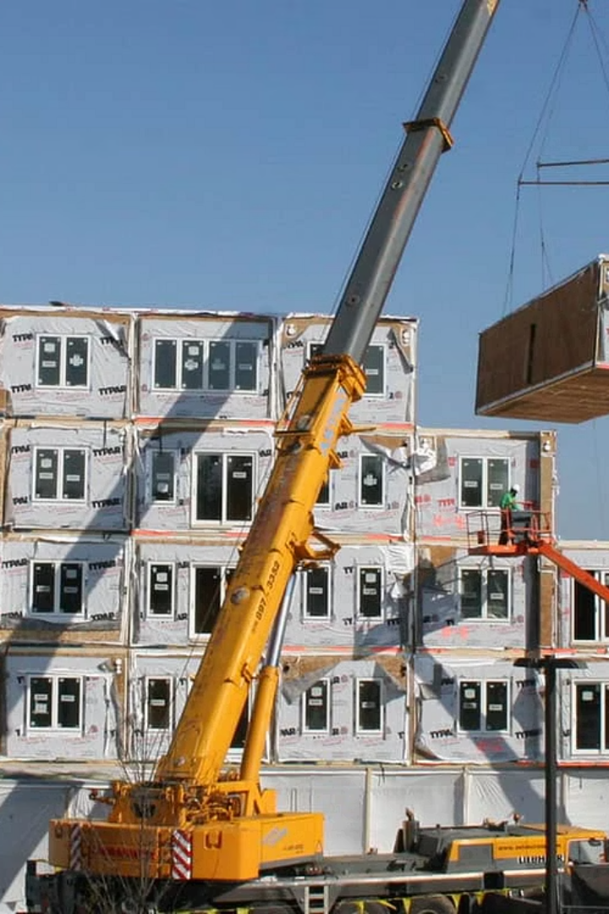
Modular Construction: Speed, Efficiency and Cost Savings
Design & Planning
Precise module designs enable fast assembly.
Offsite Fabrication
Modules built simultaneously in controlled environments.
Onsite Assembly
Quick installation reduces project timelines.
Cost Efficiency
Less labour and material waste.

Slide 6
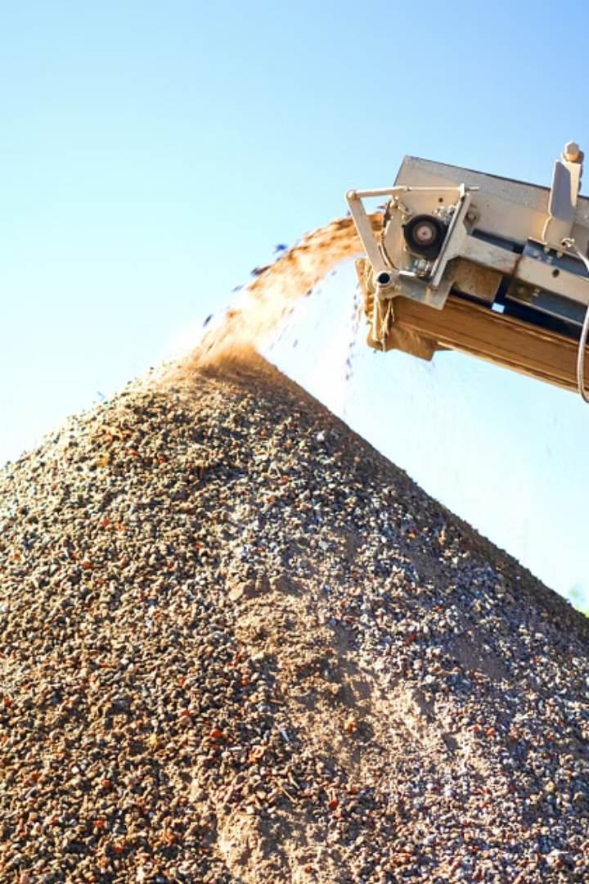
Recycled Materials: Reducing Waste and Promoting Circularity
Concrete Aggregate
Recycled Steel
Crushed waste concrete reused in new mixes.
Steel scrap melted and reformed without quality loss.
Plastic Composites
Repurposed plastics used for insulation and panels.

Slide 7
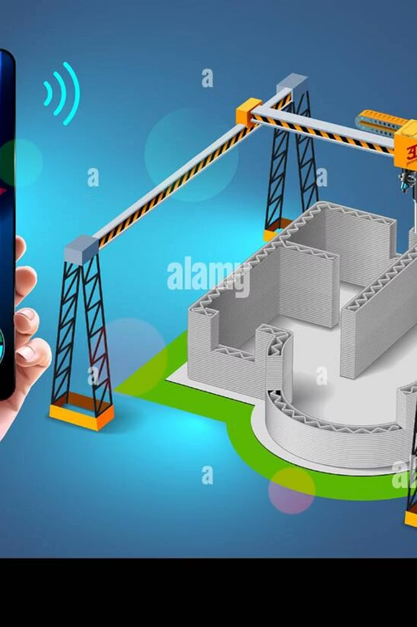




3D-Printed Building Components: Innovation and Customisation
Design Freedom
Complex shapes made easily with digital modelling.
Material Efficiency
Less waste by depositing exact amounts of material.
Rapid Production
Speeds up both prototypes and final parts.
Cost Reduction
Low labour and material costs compared to traditional methods.

Slide 8




Bio-Based Materials: Natural Alternatives for Construction
Hempcrete
Bamboo
1
2
Lightweight, insulating and carbon negative.
Strong, fast-growing renewable resource.
Cork
Mycelium
Natural insulator harvested without harming trees.
Fungal-based material with fire resistance and biodegradability.
4
3

Slide 9



Self-Healing Materials: Extending Lifespan and Reducing Maintenance
Microcapsules
1
Contain healing agents released on damage.
Crystalline Growth
2
Materials that fill cracks via chemical reactions.
Biological Healing
3
Use bacteria to precipitate mineral deposits and seal fractures.

Slide 10
The Future of Building: Trends, Challenges and Opportunities
Trends
Challenges
Opportunities
Sustainable and smart materials growth
Material cost fluctuations
Improved building performance
Regulatory hurdles for new tech
Lower environmental impact
Automation and robotics use
Skilled labour shortages
Innovative design possibilities
Modular and 3D printing expansion

